Slide 1
Prohibited Behavior (1006.14, .18, .22, .30)
The CFPB’s Notice of Proposed Rulemaking

Slide 2
Today’s Panel
Wendy Badger ECMC Group
Stephanie Schuitt iQor
Judd Peak Frost-Arnett

Slide 3
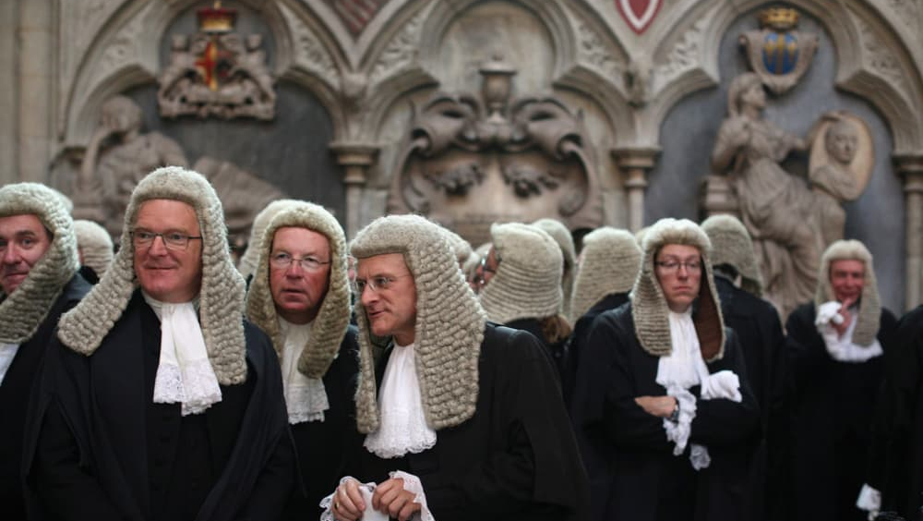
Legal Disclaimer
This presentation is intended to convey general information only and not to provide legal advice. The information conveyed is not intended and should not be construed or relied upon as legal advice. As legal advice must be tailored to the specific circumstances of each case, please consult with your own legal advisor or attorney with respect to your particular situation. While every effort has been made to assure this information is up-to-date, they are not promised or guaranteed to be current, complete or up-to-date.

Slide 4
Agenda
Harassing, oppressive, or abusive conduct (1006.14)
False, deceptive, or misleading representations or means (1006.18)
Unfair or unconscionable means (1006.22)
Other prohibited practices (1006.30)

Slide 5
1006.14 – Harassing, Oppressive, or Abusive Conduct
Notes:
Schuitt

Slide 6
1006.14 – Harassing, Oppressive, or Abusive Conduct
Section 14 restates section 1692d of the FDCPA with regards to harassment and abuse.
It clarifies FDCPA section 806(5) that prohibits a debt collector from “causing a telephone to ring or engaging any person in telephone conversation repeatedly or continuously with intent to annoy, abuse, or harass any person at the called number.”
It does this by proposing a “7 calls in 7 days” limit, with 1 contact per 7 days.
Notes:
Schuitt

Slide 7
Exceptions from Frequency Limits
The consumer making a request for information.
The debt collector receives consent directly from the consumer.
The call did not connect to the dialed number.
Communication with the consumer’s attorney, a consumer reporting agency, if otherwise permitted by law, the creditor, the creditor’s attorney, or the debt collector’s attorney.
Emails and texts are allowed – with no frequency attached. However, the harassment piece still stands.
Notes:
Schuitt – REMINDER: discuss email, text

Slide 8
Stresses, Changes, and Risks to Business Practices
Update business rules in their dialing system/collection management system to ensure that no more than 7 calls and one contact are made per debt in a consecutive 7-day period.
This will take planning and programming resources and changes to operational policies and procedures.
Compliance departments will have to add a call frequency audit and a contact frequency audit into their audit schedules.
Violating call frequency limits and being subject to lawsuits and potential investigation by the CFPB.
Notes:
Peak

Slide 9
Open Questions / How to Comply
Question: The section says that for student loan debt the frequency would include all debt held under the same account number. However, each loan would have its own account number.
Because much of the section mirrors the current FDCPA rules, the main area with which agencies will need to comply is the call frequency limitations.
Ensure dialing system has proper controls for dialing rules.
Create audit functions to verify compliance.
Notes:
Badger

Slide 10
1006.18 – False, Deceptive or Misleading Representations or Means

Slide 11
1006.18 – False, Deceptive or Misleading Representations or Means
Almost exact duplicate of the FDCPA section 1692e dealing with false and misleading representations with two (2) additional topics:
Aliases - allows for a debt collector to use an alias, as long as it is consistently used and easily identifiable to the real person.
Meaningful attorney involvement-requires an attorney to either draft or review the pleading, motion or other document and to review the information that supports those documents, in order to satisfy the “meaningful involvement” requirement.
Notes:
Badger

Slide 12
Changes to Business Practices
Because this section is almost an exact duplicate of the FDCPA, if an agency is already compliant with FDCPA and CFPB memos/consent orders, there shouldn’t be any meaningful changes needed
With regards to aliases, agencies need to be aware (if not already) of state laws regarding the use of aliases.
Notes:
Badger

Slide 13
Stresses and Risks to Business Practices
Create a solid CMS which includes a section (or a specific policy) on false, deceptive, or misleading representations.
Align training to set out the expectations with regards to these items.
Audit compliance to the training and expectations (call monitoring would be the primary audit).
If you are a law firm who has atty involvement, make sure you can show meaningful involvement.
Notes:
Schuitt -- CFPB is attempting to prevent the past practice of some firms robo-signing lawsuits where it’s clear that the attys could not have had meaningful involvement to review the lawsuits based on the large volume.

Slide 14
Open Questions / How to Comply
Continue abiding by the FDCPA and update or create a solid Compliance Management System based on the CFPB’s Compliance Program and Control Components which consist of the following sections:
Board and Management Oversight
Policies and Procedures
Training
Monitoring and Auditing
Consumer Complaint Response
Notes:
Schuitt

Slide 15
1006.22 -- Unfair or Unconscionable Means

Slide 16
1006.22 – Unfair or Unconscionable Means
Generally, restates current FDCPA §1692f prohibition on “unfair” or “unconscionable” conduct by a debt collector.
Proposed rule expands definition, and includes specific examples.
Notes:
Peak

Slide 17
New Examples of Unfair or Unconscionable Conduct
Collection of “unauthorized” amounts
Early deposit of post-dated payment
Improper concealed charges
Threats regarding seizure of property
Communication via postcards or use of envelope markings
Email communications to consumer’s POE (new)
Social media communications that are viewable by 3rd parties (new)
Notes:
Peak

Slide 18
What Does This Mean for Business Practices?
Changes for electronic communications methods
Safeguards necessary for email / social media (Facebook, Twitter, etc.)
Email scrubs / verification services?
Safe harbor – compliance with 1006.6(d)
Notes:
Badger

Slide 19
Risk Mitigation
Training – collectors on social media.
Monitoring and audit of electronic communications (email).
Need for written policies / procedures.
Establish bona fide error defense
Prevent class action status for violations
Notes:
Badger

Slide 20
1006.30 – Other Prohibited Practices

Slide 21
1006.30 – What Does the Rule Say?
Debt collector must notify the consumer prior to furnishing data to the CRAs.
It constitutes a UDAAP violation if the debt collector sells, transfers, or places an account to collections if the debt collections knows or should know:
A debt collector must apply payment in the manner prescribed by the consumer and may not apply payment to a disputed debt.
the debt has been paid or settled
the debt has been discharged in bankruptcy
the consumer has filed an Identity Theft Report concerning the debt
Notes:
Schuitt
A debt collector who brings legal action to enforce an interest in real property must do so in the judicial district in which the property is located; a debt collector who brings legal action against a consumer to collect must bring it in the judicial district in which the consumer resides or where the underlying contract was signed.
A debt collector “must not” design, compile, and furnish any form that the debt collector knows would be used to cause a consumer falsely to believe that a person other than the consumer’s creditor is participating in collecting or attempting to collect a debt.

Slide 22
1006.30 – Changes to Business Practices?
Many debt collectors are already following these rules.
With regards to furnishing data to the CRAs without notifying the consumers, any agency that currently engages in this type of collections will need to modify their practices to send out notice letters prior to reporting.
Ensure the appropriate disposition/account status is reflected at the time of any potential sale, transfer or new placement so that these types of debts (paid/settled, discharged or Identity Theft Report) are excluded.
Notes:
Peak

Slide 23
1006.30 – Stresses & Risks
The rule for credit reporting without active collections could put a stress on agencies currently engaged in this type of collections.
For sale/transfer, etc. – despite good faith efforts, errors/mistakes could be made due to timing issues or not receiving updates regarding bk/dec accounts.
Failure to notify the consumer their debt will be reported. What does the CFPB consider “Communicating” prior to reporting. Do agencies good faith efforts to send a letter to last known address count?
Not knowing a debt has been paid or settled due to timing issues; potential fraudulent claims of ID theft to get out of the debt.

Slide 24
Effective Practices

Slide 25
Effective Practices
Document, document, document.
Test, monitor and audit.
Rethink credit reporting as a collection tool strategy.
Ensure policies, procedures, and rules are up to date with these requirements.
Ensure dialing system has proper controls for dialing rules.
Align training to set out the expectations with regards to these items.
Create audit functions to verify compliance.
Audit compliance to the training and expectations (call monitoring would be the primary audit).
Make sure your technology properly tracks call frequency caps, and prevents calling in excess of those caps.
Notes:
Schuitt
A debt collector who brings legal action to enforce an interest in real property must do so in the judicial district in which the property is located; a debt collector who brings legal action against a consumer to collect must bring it in the judicial district in which the consumer resides or where the underlying contract was signed.
A debt collector “must not” design, compile, and furnish any form that the debt collector knows would be used to cause a consumer falsely to believe that a person other than the consumer’s creditor is participating in collecting or attempting to collect a debt.

